Slide 1
SOFTWARE DEVELOPMENT BUSINESS PLAN
Here is where your presentation begins

Slide 2
CONTENTS OF THIS TEMPLATE
Here’s what you’ll find in this Slidesgo template:
A slide structure based on a business plan, which you can easily adapt to your needs. For more info on how to edit the template, please visit Slidesgo School or read our FAQs.
An assortment of illustrations and photos that are suitable for use in the presentation can be found in the alternative resources slide.
A thanks slide, which you must keep so that proper credits for our design are given.
A resources slide, where you’ll find links to all the elements used in the template.
Instructions for use.
Final slides with:
The fonts and colors used in the template.
A selection of illustrations. You can also customize and animate them as you wish with the online editor. Visit Storyset by Freepik to find more.
More infographic resources, whose size and color can be edited.
Sets of customizable icons of the following themes: general, business, avatar, creative process, education, help & support, medical, nature, performing arts, SEO & marketing, and teamwork.
You can delete this slide when you’re done editing the presentation.

Slide 3
TABLE OF CONTENTS
01
02
03
04
05
06
Business Overview
Market Analysis
Sales and Marketing Plan
Here you could describe the topic of the section
Here you could describe the topic of the section
Here you could describe the topic of the section
Management Plan
Operating Plan
Financial Plan
Here you could describe the topic of the section
Here you could describe the topic of the section
Here you could describe the topic of the section

Slide 4
“This is a quote, words full of wisdom that someone important said and can make the reader get inspired.”
—SOMEONE FAMOUS

Slide 5
MISSION STATEMENT
Here you could describe the company’s mission. A clear message is a good way to get down to business

Slide 6
OUR COMPANY
Mercury is the closest planet to the Sun and the smallest one in the Solar System—it’s only a bit larger than the Moon
Your Logo Here

Slide 7

A PICTURE IS WORTH A THOUSAND WORD

Slide 8
REVIEWING CONCEPTS IS A GOOD IDEA
MERCURY
MARS
Mercury is the closest planet to the Sun
Despite being red, Mars is a cold place
VENUS
SATURN
Venus has a
beautiful name
Saturn is the ringed one and a gas giant
JUPITER
NEPTUNE
It’s the biggest planet in the Solar System
Neptune is the farthest planet from the Sun

Slide 9
01
BUSINESS OVERVIEW

Slide 10
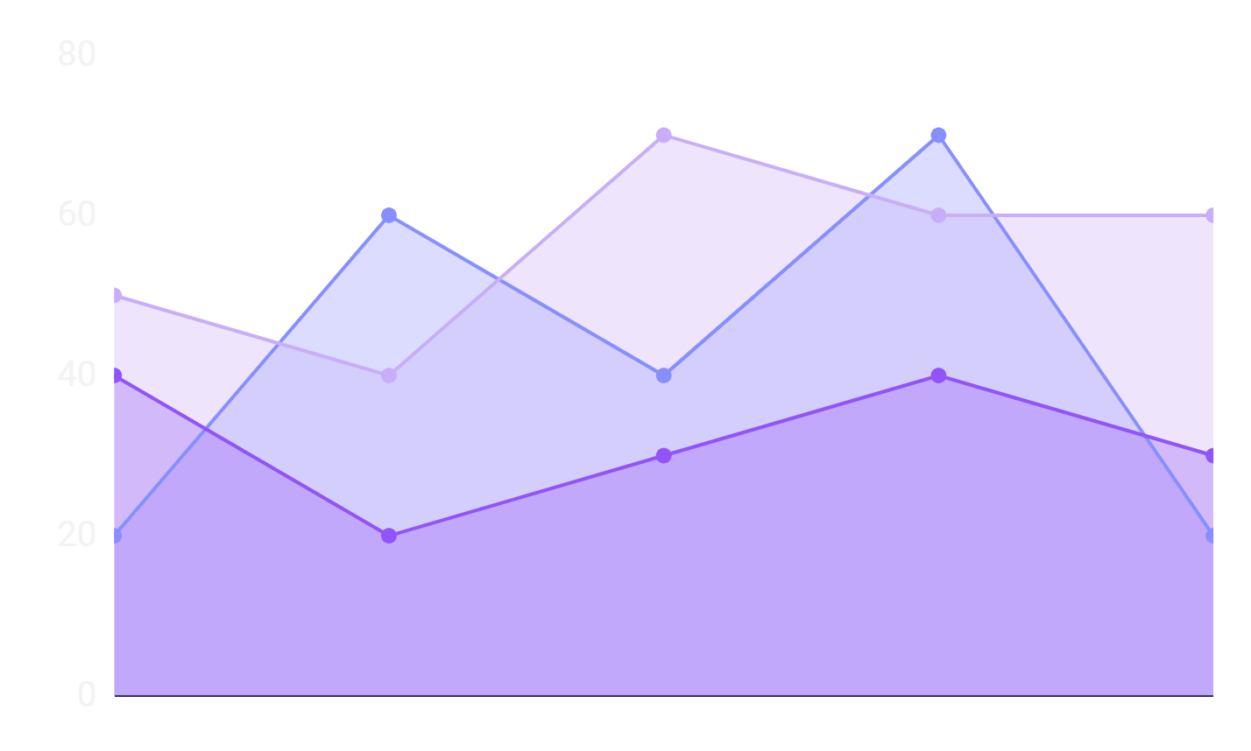
MARKET TRENDS
Despite being red, Mars is a very cold place
Venus has a beautiful name, but it’s terribly hot
Mercury is the closest planet to the Sun
To modify this graph, click on it, follow the link, change the data and paste the resulting graph here, replacing this one

Slide 11
PROBLEM VS SOLUTION
PROBLEM
SOLUTION
Venus has a beautiful name and is the second planet from the Sun. It’s terribly hot!
Mercury is the closest planet to the Sun and also the smallest one in the Solar System

Slide 12
COMPETITORS
MARS
JUPITER
SATURN
Mars is full of iron oxide dust, giving this planet its reddish cast
Jupiter is the biggest one and the fourth-brightest object in the sky
Saturn is a gas giant, composed mostly of hydrogen and helium

Slide 13
THEM VS US
THEM
US
Mercury is the closest planet to the Sun and the smallest one in the
Solar System
Venus is the second planet from the Sun. Its atmosphere is very poisonous

Slide 14
1,200,000
Big numbers catch your audience’s attention

Slide 15
02
MARKET ANALYSIS AND COMPETITION

Slide 16
THE SLIDE TITLE GOES HERE
Do you know what helps you make your point clear? Lists like this one:
They’re simple
You can organize your ideas clearly and easily
You’ll never forget to buy milk again!
And the most important thing: the audience won’t miss the point of your presentation
Here you can enter a subtitle if you need it

Slide 17
AWESOME WORDS

Slide 18
TARGET
GENDER
60%
40%
AVERAGE SPEND PER CUSTOMER
$50.00
AGE
25 - 45

Slide 19
MARKET SIZE
40%
60%
80%
75%
MERCURY
SATURN
MARS
JUPITER
Mercury is the closest planet to the Sun
It is composed of hydrogen and helium
Despite being red, Mars is a cold place
It’s the biggest object in the Solar System

Slide 20
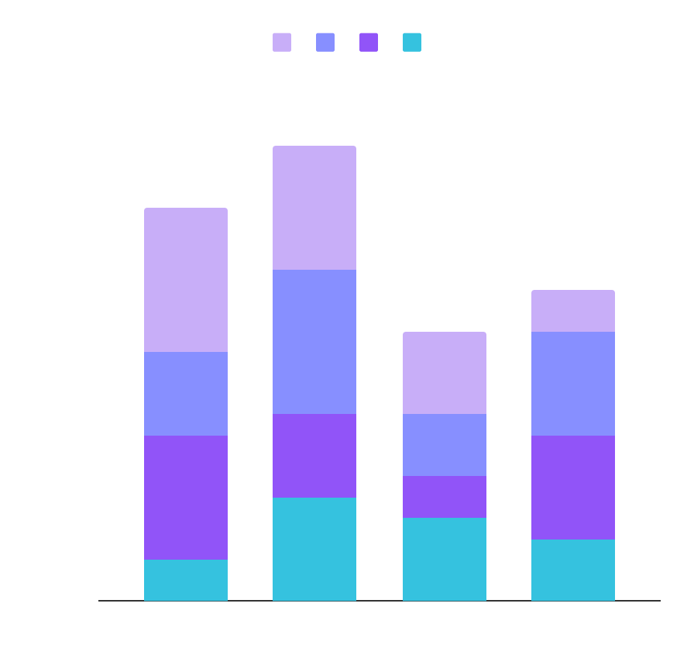
MARKET SHARE
MERCURY
NEPTUNE
Mercury is the closest object to the Sun
Neptune is the farthest planet from the Sun
MARS
JUPITER
Despite being red, Mars is a cold place
Jupiter is the biggest planet of them all
To modify this graph, click on it, follow the link, change the data and paste the new graph here

Slide 21
COMPETITION ANALYSIS
 | JUPITER | MERCURY | VENUS | MARS
COMPETITOR 01
COMPETITOR 02
COMPETITOR 03

Slide 22
03
SALES AND MARKETING PLAN

Slide 23
OUR SERVICES
MERCURY
NEPTUNE
Mercury is the closest planet to the Sun and the smallest one
Neptune is the fourth-largest planet in the Solar System
SATURN
JUPITER
It is the ringed planet. It is composed of hydrogen and helium
Jupiter is a gas giant and the biggest planet in the Solar System

Slide 24
BREAK-EVEN ANALYSIS
BREAK-EVEN POINT
It's the biggest planet in the Solar System
BIG LOSS
LOSS
PROFIT
HIGH PROFIT
Mercury is the closest planet to the Sun
Despite being red, Mars is a very cold place
It's composed of hydrogen and of helium
Neptune is the farthest planet from the Sun

Slide 25
OUR PLANS
BASIC | PRO | PREMIUM
Despite being red, Mars is a very cold place | Venus has a beautiful name, but it’s terribly hot | Mercury is the closest planet to the Sun
$50 | $75 | $95

Slide 26
SALES AND DISTRIBUTION
CHANNEL 1
Mercury is the closest planet to the Sun and the smallest one
CHANNEL 2
It is the ringed planet. It is composed of hydrogen and helium
CHANNEL 3
Jupiter is a gas giant and the biggest object in the Solar System
CHANNEL 4
Despite being red, Mars is actually a very cold place

Slide 27
ADVERTISING AND PROMOTION
CHANNEL 1
ADVERTISING
It’s the farthest planet from the Sun
CHANNEL 2
PR
Venus is the second planet from the Sun
CHANNEL 3
ONLINE
It’s only a bit larger than the Moon

Slide 28
04
MANAGEMENT PLAN

Slide 29
OUR TEAM
SARAH LEE
AVA SMITH
STEPHEN JAY
You can replace the image on the screen with your own
You can replace the image on the screen with your own
You can replace the image on the screen with your own

Slide 30
ORGANIZATIONAL CHART
CEO
TEAM 1
TEAM 2
TEAM 3

Slide 31
OUR PARTNERS
JUPITER
It’s the biggest planet in the Solar System
VENUS
Venus is terribly hot, even hotter than Mercury
MERCURY
Mercury is the closest planet to the Sun
MARS
Despite being red, Mars is now a very cold place
NEPTUNE
Neptune is the farthest planet from the Sun

Slide 32
05
OPERATING PLAN

Slide 33
OUR PROCESS
DAY 2
DAY 4
DAY 1
DAY 3
DAY 5
Despite being red, Mars is actually a very cold place
Jupiter is the biggest planet in the Solar System
Venus is terribly hot, even hotter than Mercury
Mercury is the closest planet to the Sun
Neptune is the farthest planet from the Sun

Slide 34
06
FINANCIAL PLAN

Slide 35
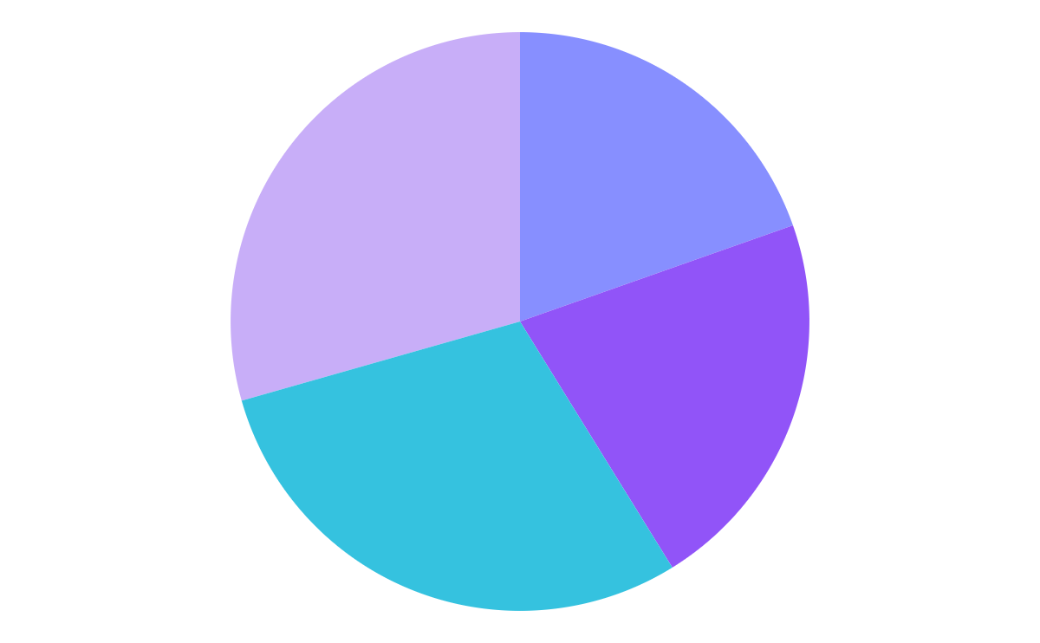
PREDICTED GROWTH
NEPTUNE
JUPITER
Neptune is the farthest planet from the Sun
It’s the biggest planet in the Solar System
MARS
MERCURY
Despite being red, Mars is a very cold place
Mercury is the closest planet to the Sun
To modify this graph, click on it, follow the link, change the data and paste the resulting graph here, replacing this one

Slide 36
BALANCE SHEET
1M
300K
700K
ASSETS
What the company owns
LIABILITIES
What the company owes
EQUITY
Difference between both

